Slide 1
Interactive Dashboard for Sales of Financial Products
A.THANISHKA
07-08-2025

Slide 2
Objective
Design an interactive dashboard for business stakeholders
Analyze sales performance and agent productivity
Provide insights to support decision-making

Slide 3
Dataset Overview
Dataset: Sales of Financial Products (Kaggle)
Key fields used: Agent_Name, ProductSold, CallID, PickedUp, Duration
No date field present, created a dummy date for time-series analysis

Slide 4
Data Preparation
Cleaned missing/inconsistent values
Created Dummy Date field to enable time-series analysis

Slide 5
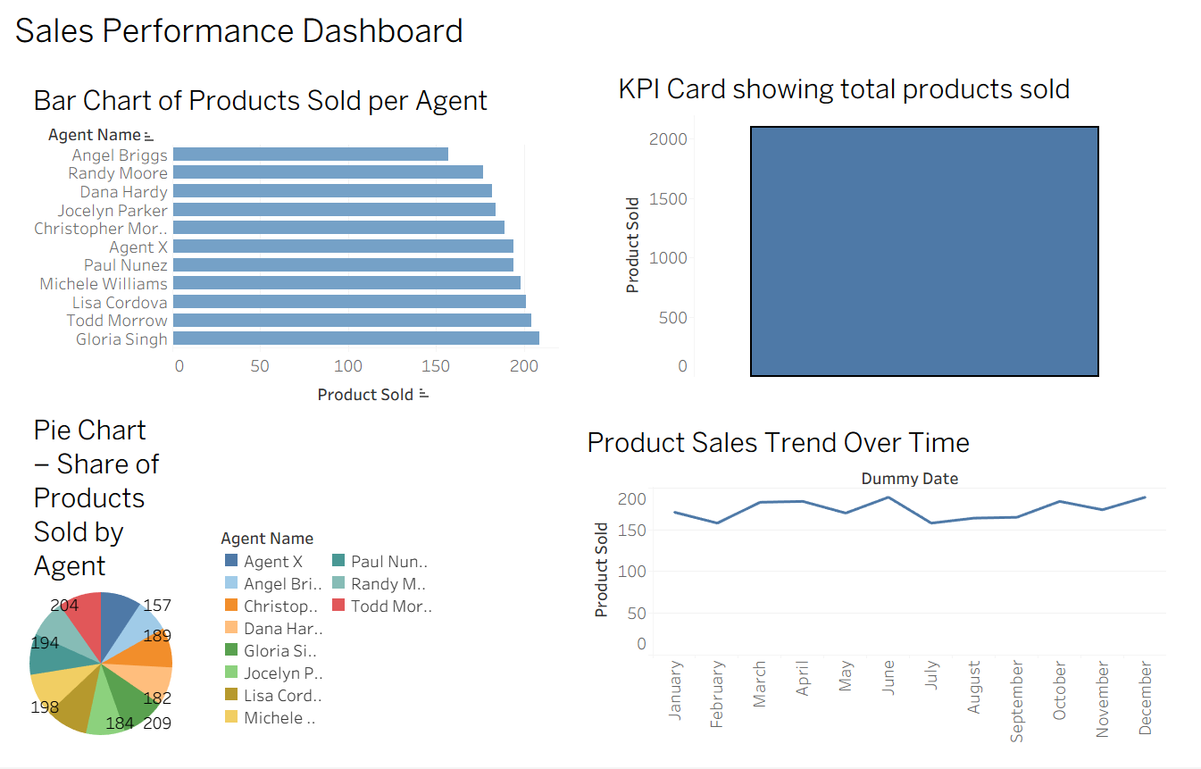
Visualizations Created
Bar Chart: Products sold by each agent
KPI Card: Total products sold summary
Pie Chart: Share of products sold by agents
Line Chart: Product sales trend over time (using dummy date)

Slide 6
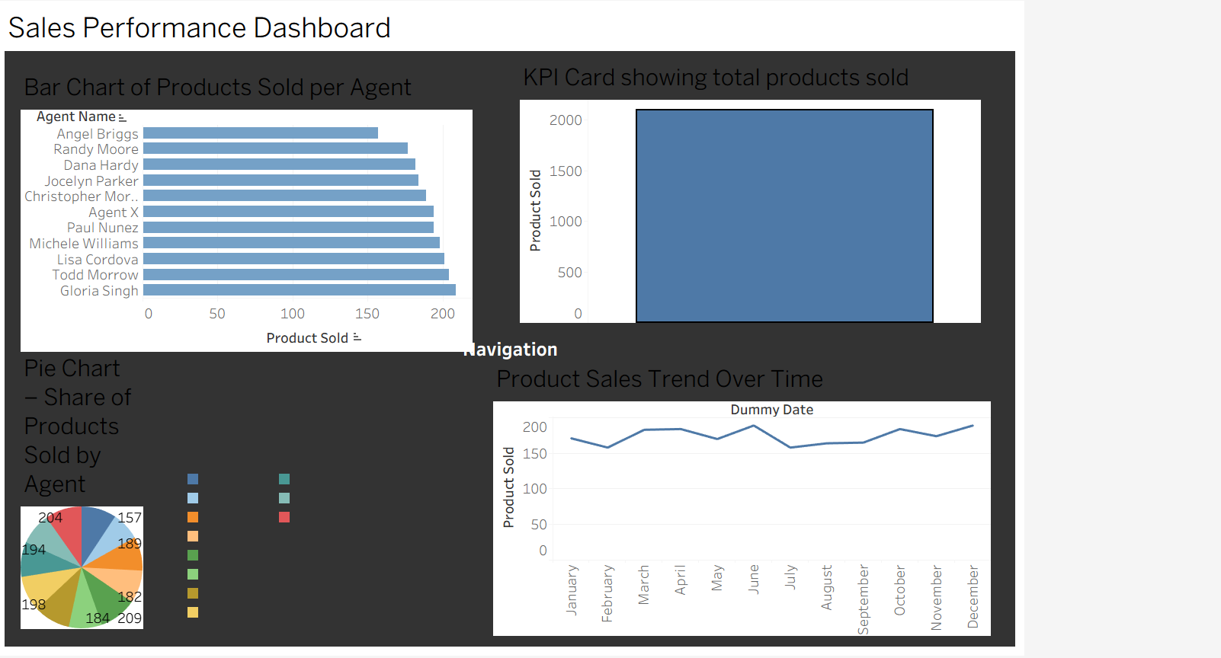
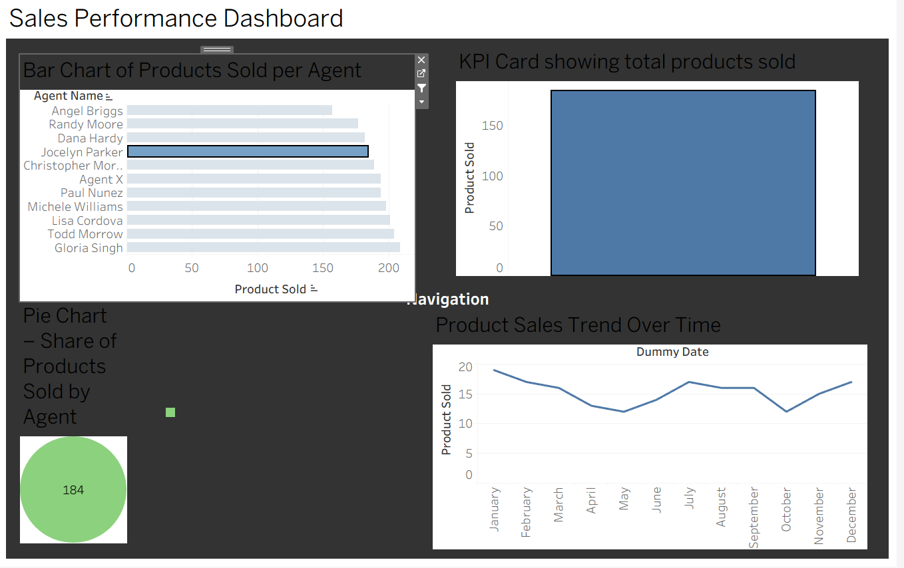
Dashboard Features
Interactive filters and slicers for agent-wise selection
Consistent color theme applied across visuals
Navigation button added for user-friendly experience
Clean layout with titles and labels for clarity

Slide 7
Key Insights
Agent-wise sales performance comparison
Overall product sales trend over simulated time
Distribution of products sold among agents
Highlights to guide business focus and improve sales

Slide 8
Conclusion
Dashboard supports informed business decisions
Can be enhanced with real date/time data for richer insights

